Slide 1


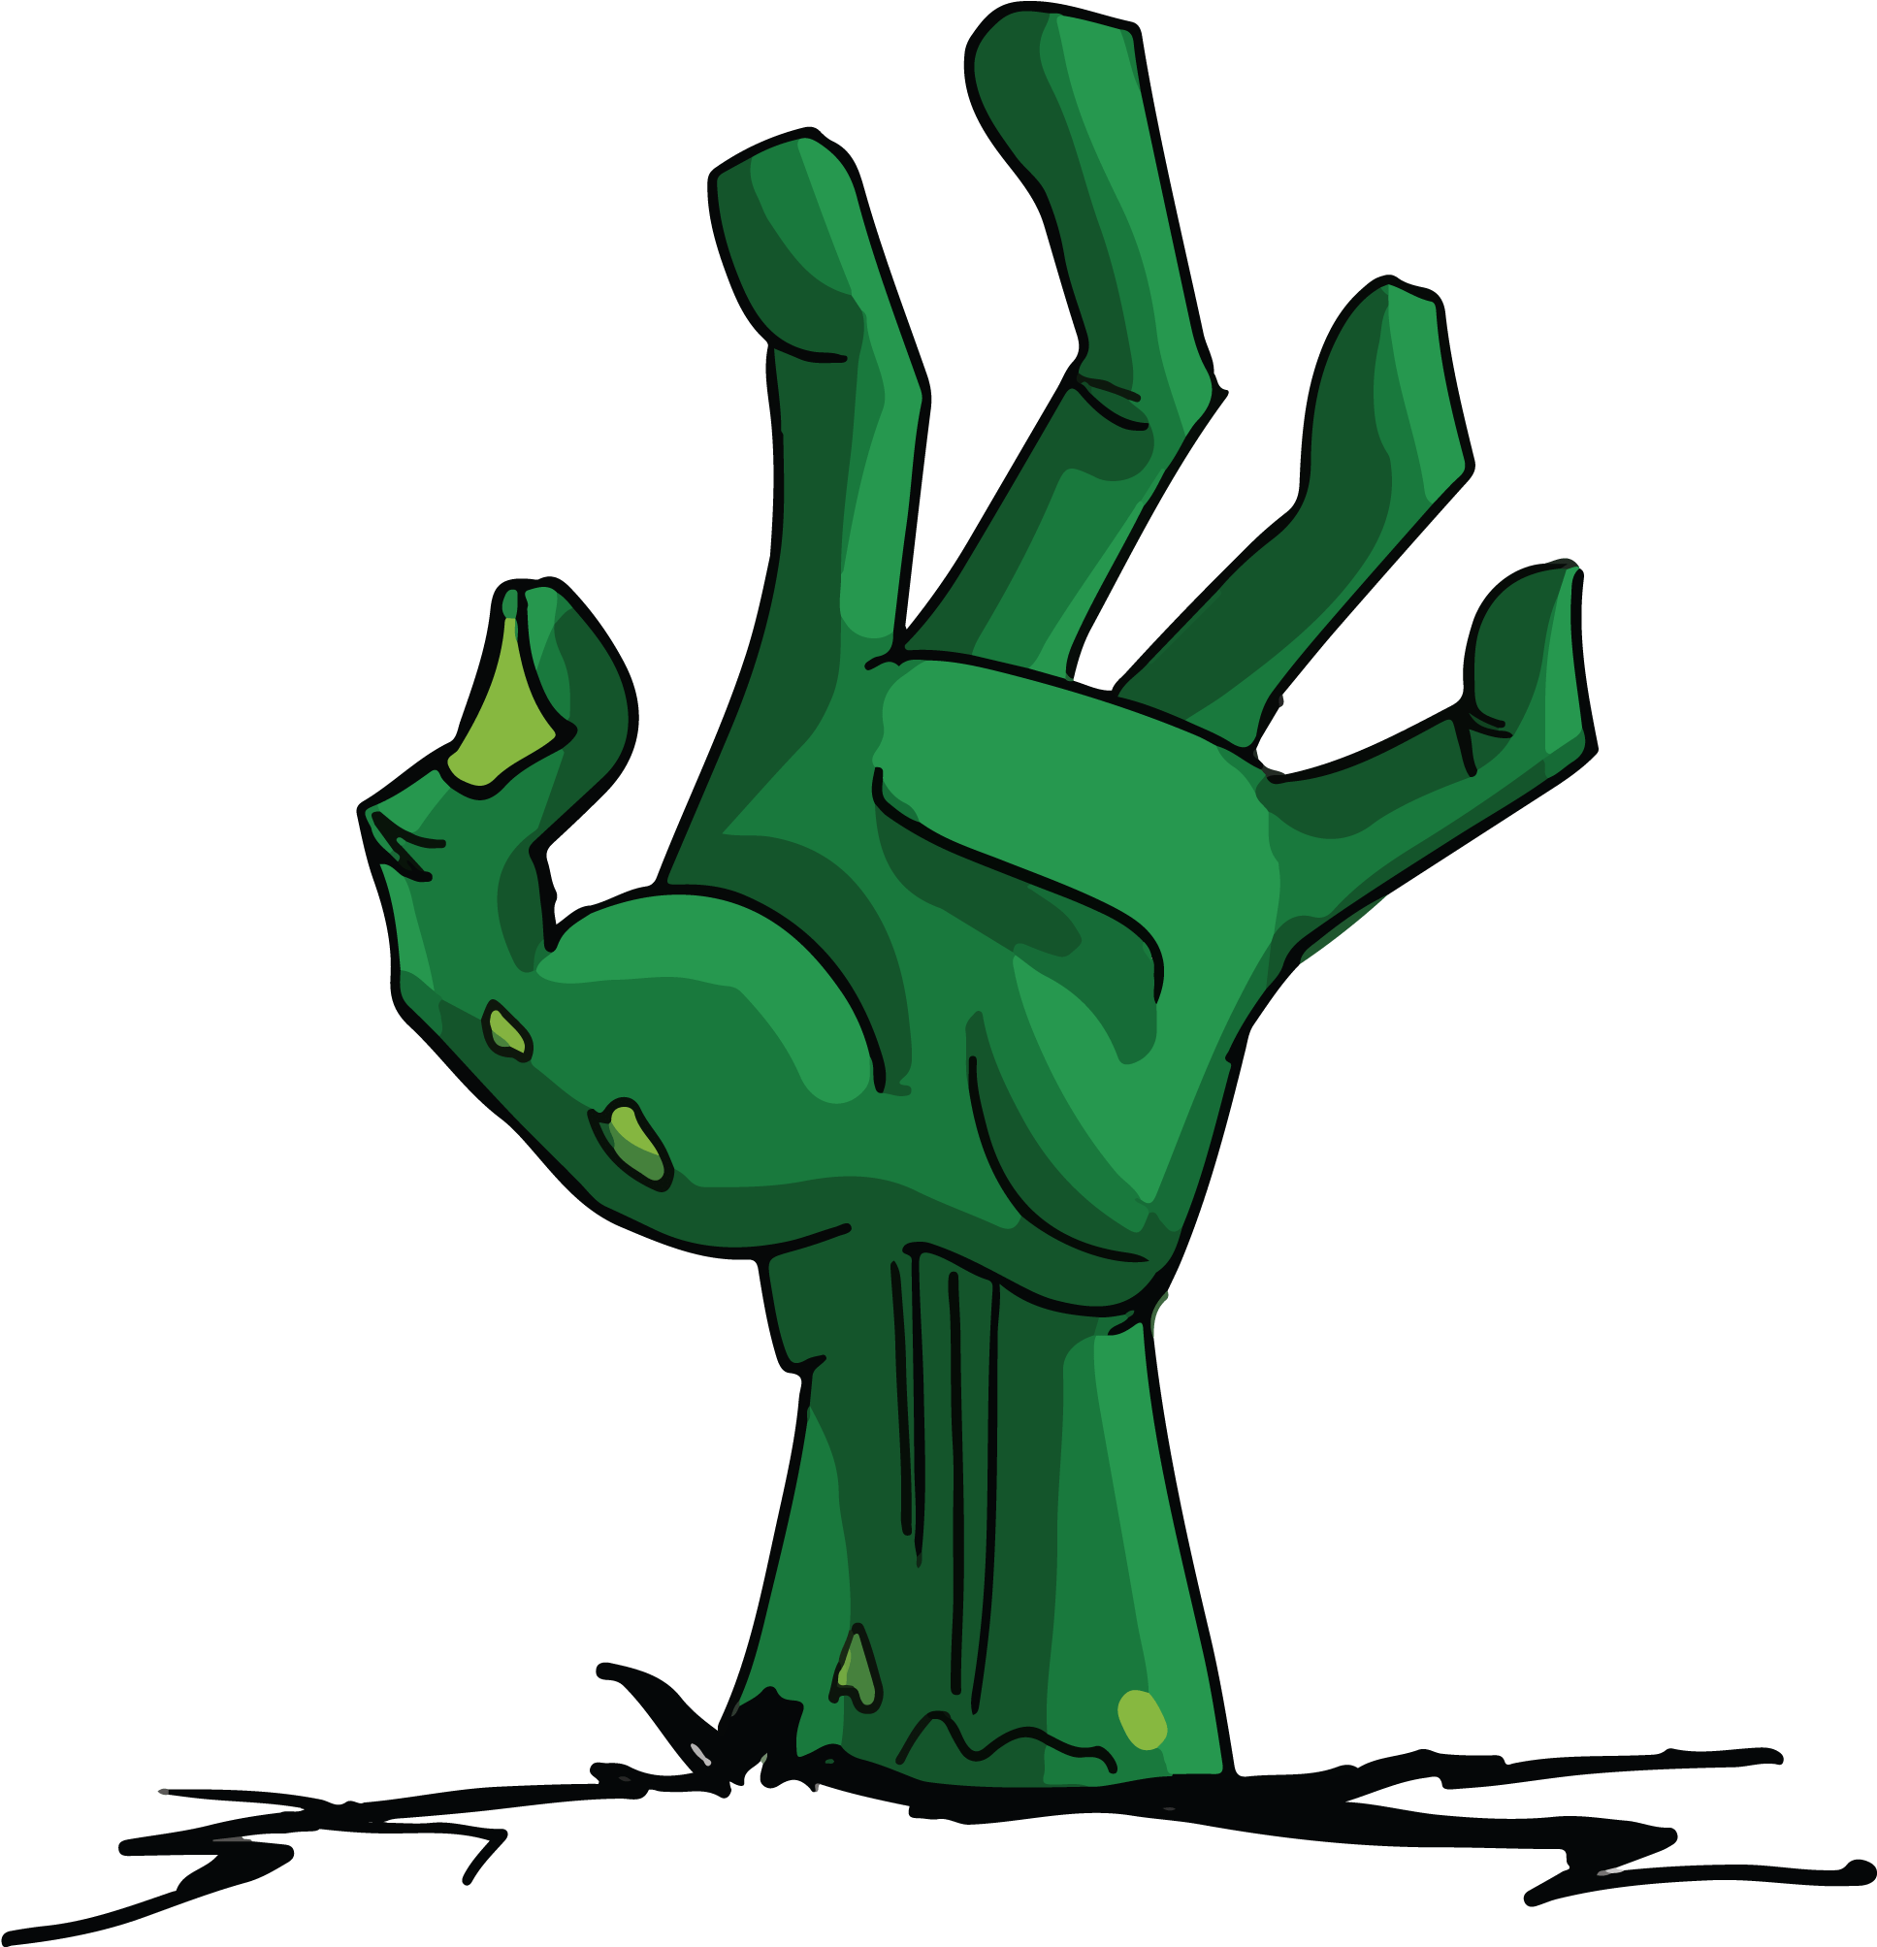
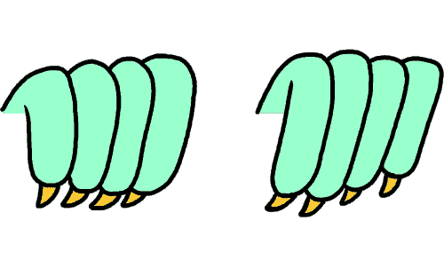
Necro Nursery
Team Abra-cadaver

Slide 2

Narrative
Updated all documents so they all reflect the same things.
Research for another monster (Possible plants and history)

Slide 3


Audio
Not much to report. Everything needed for nanocon is created
Needs to be put into unity

Slide 4
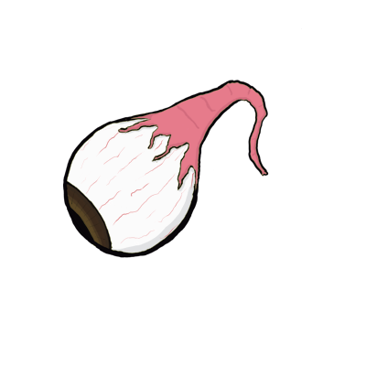


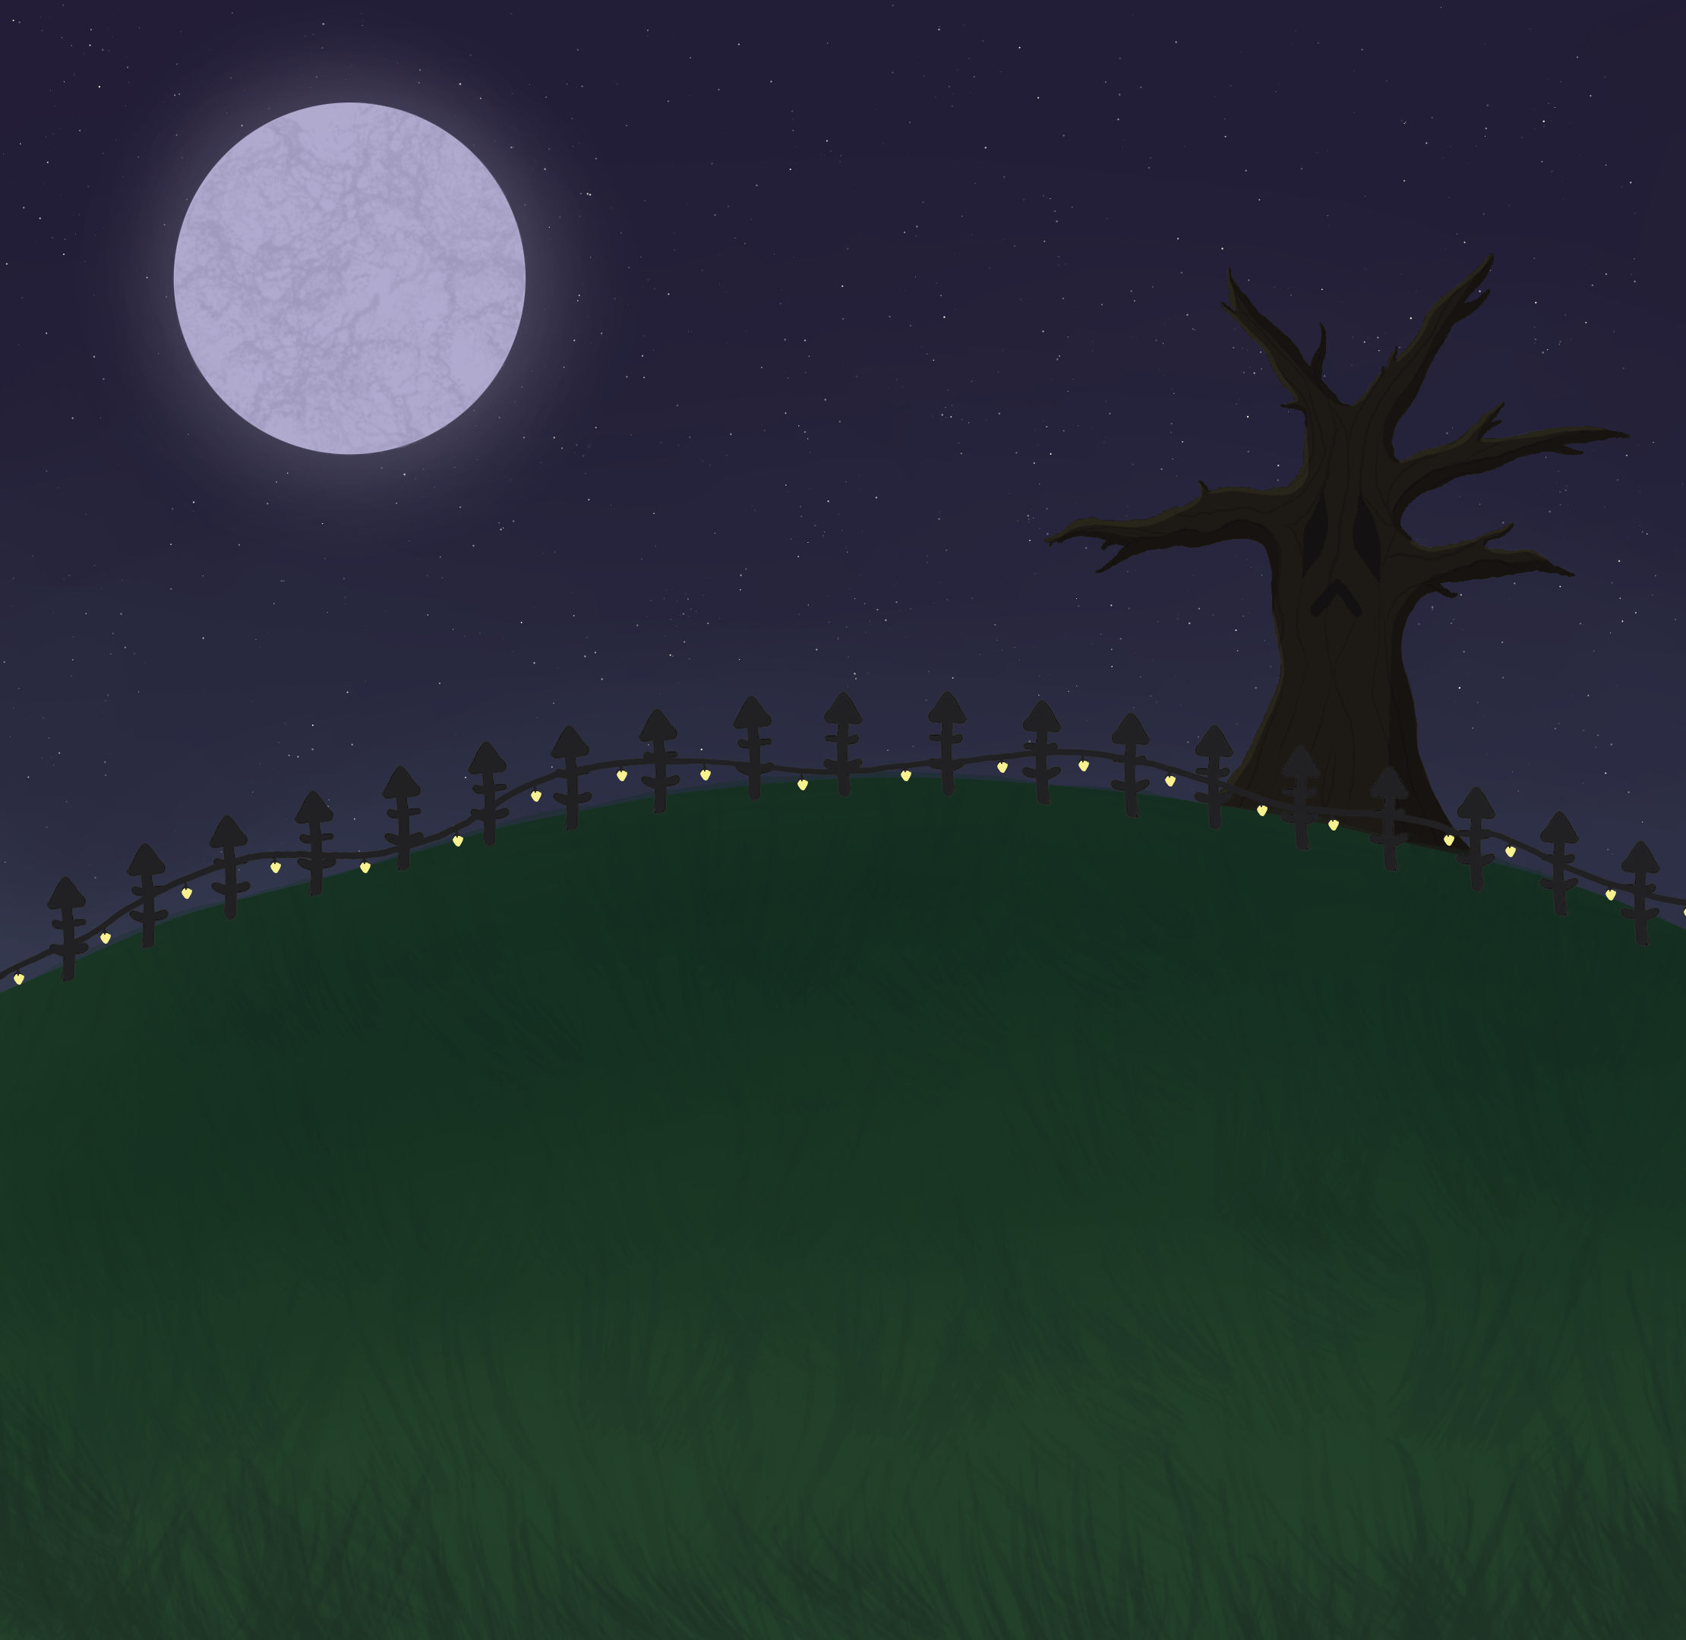


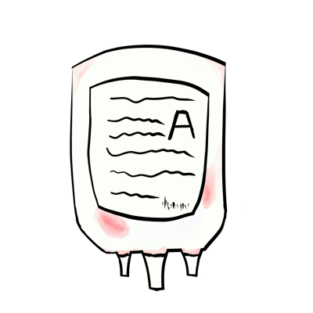

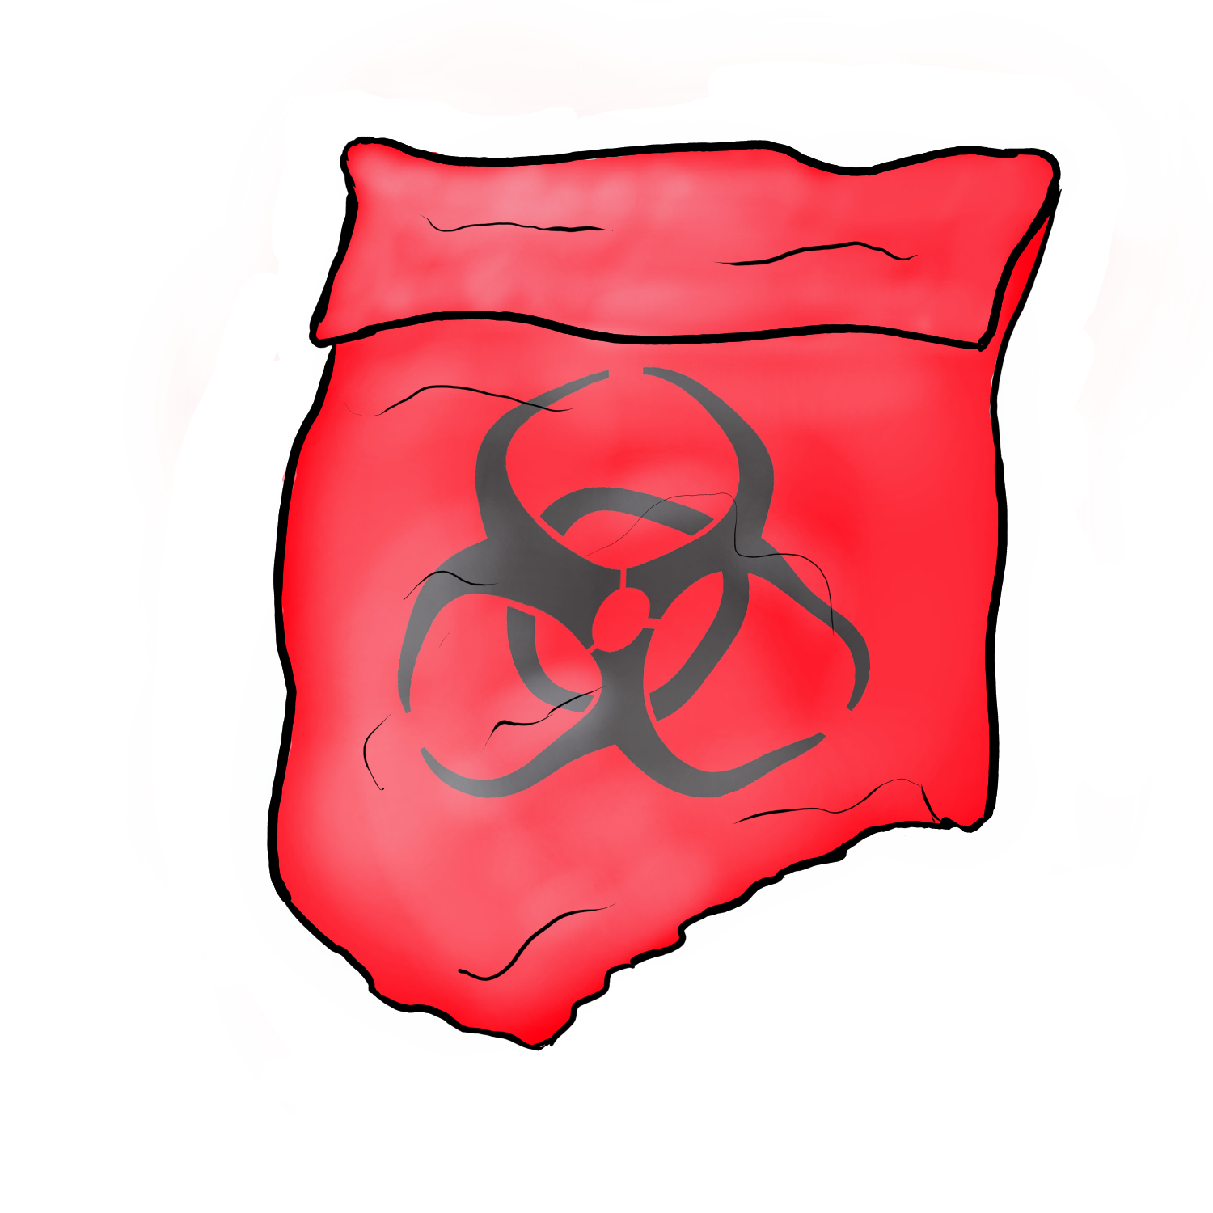


Slide 5
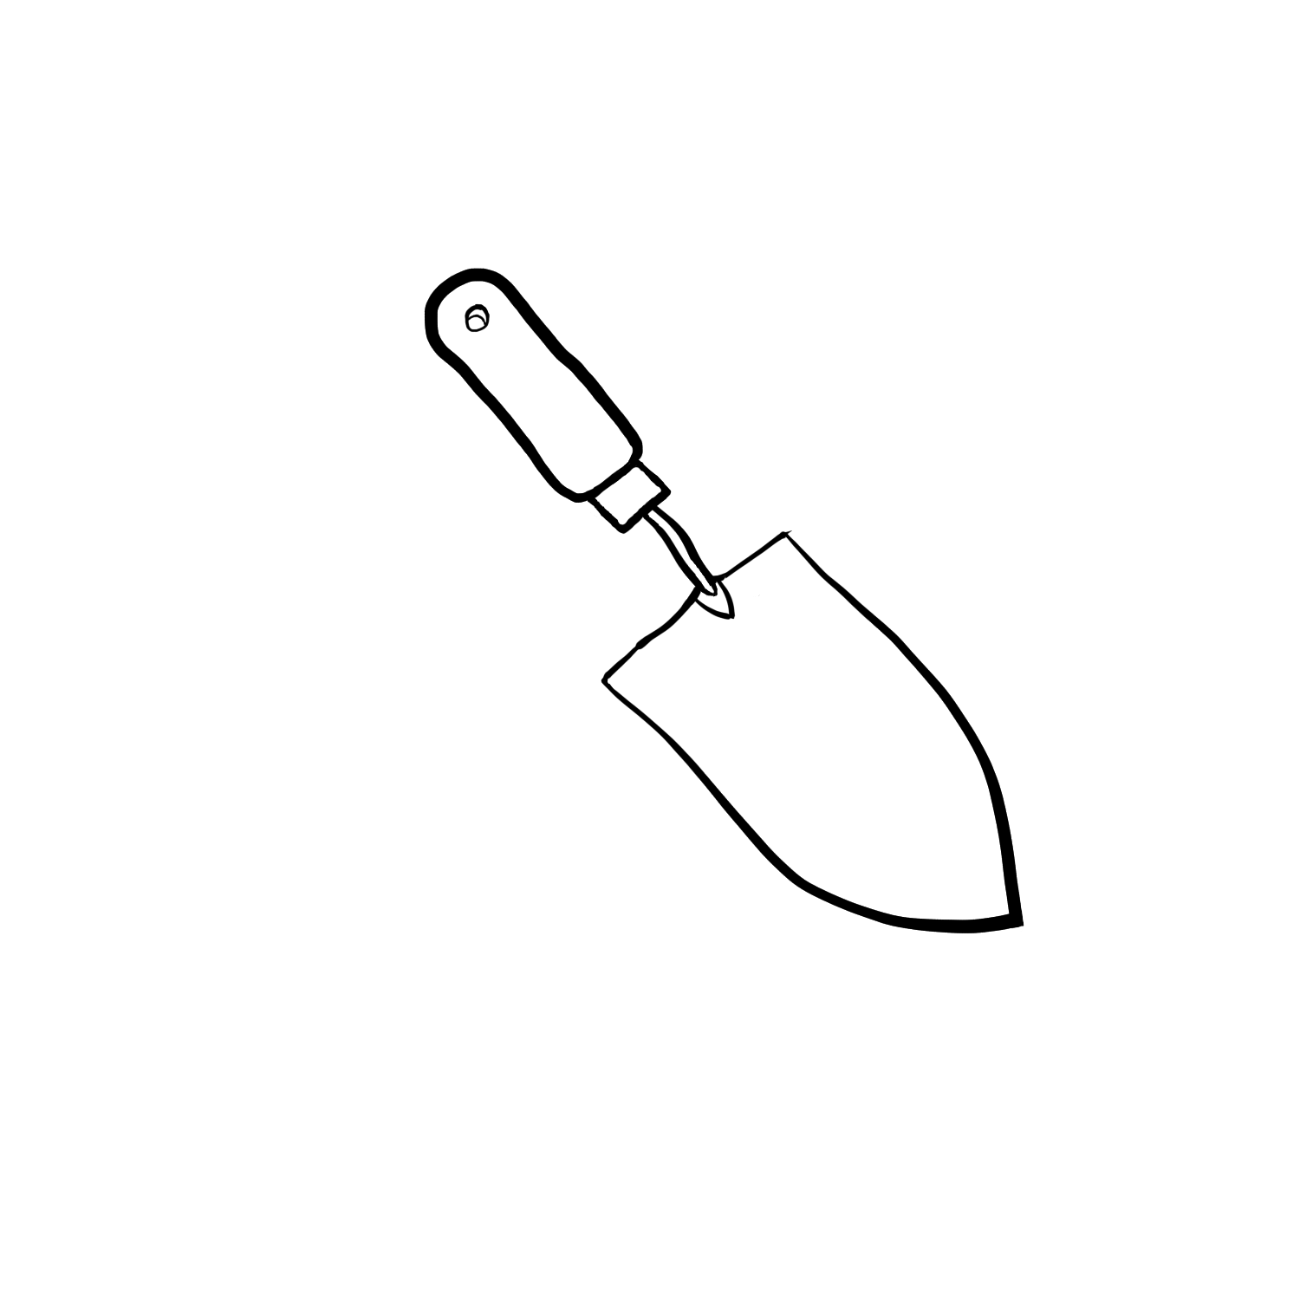
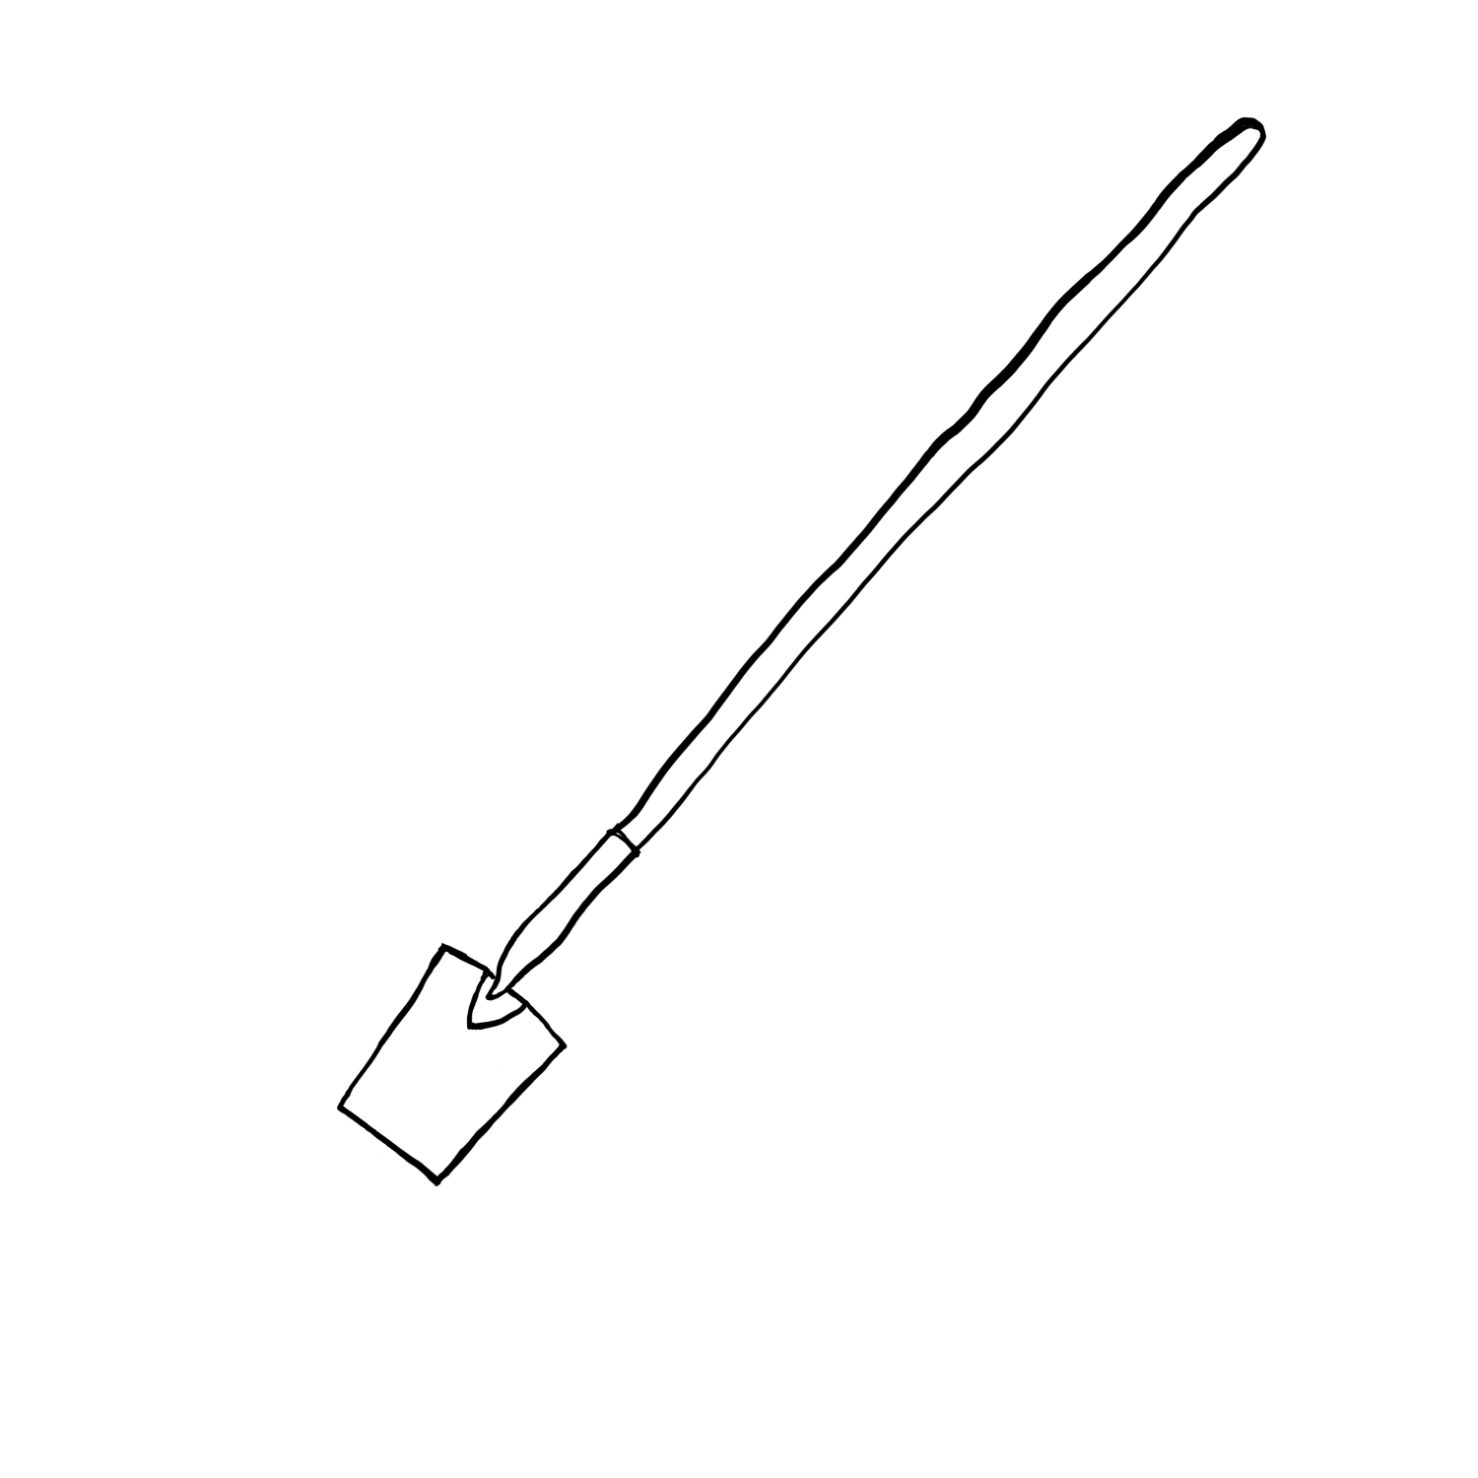


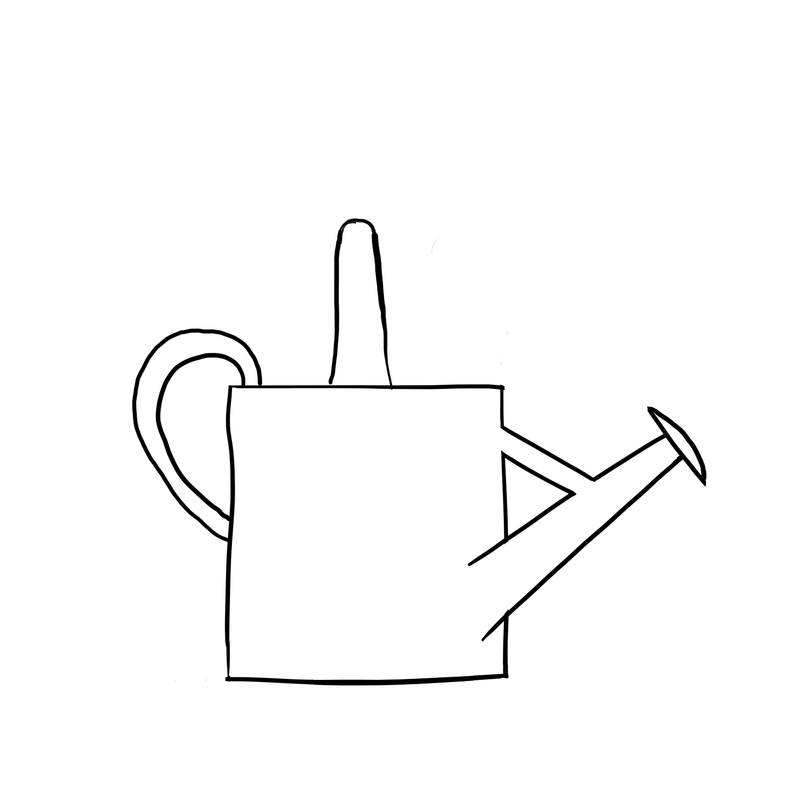

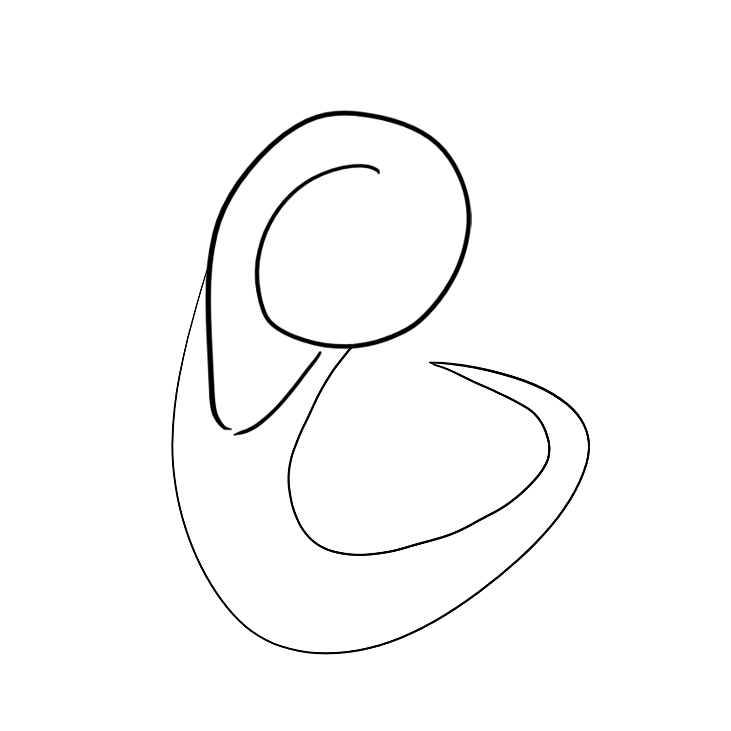

Slide 6
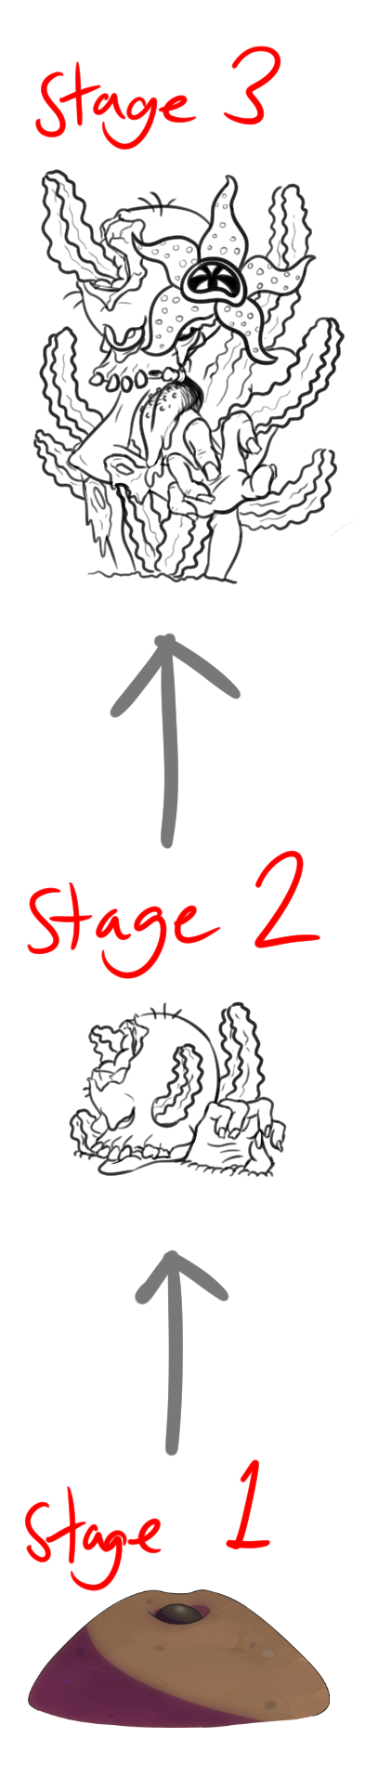
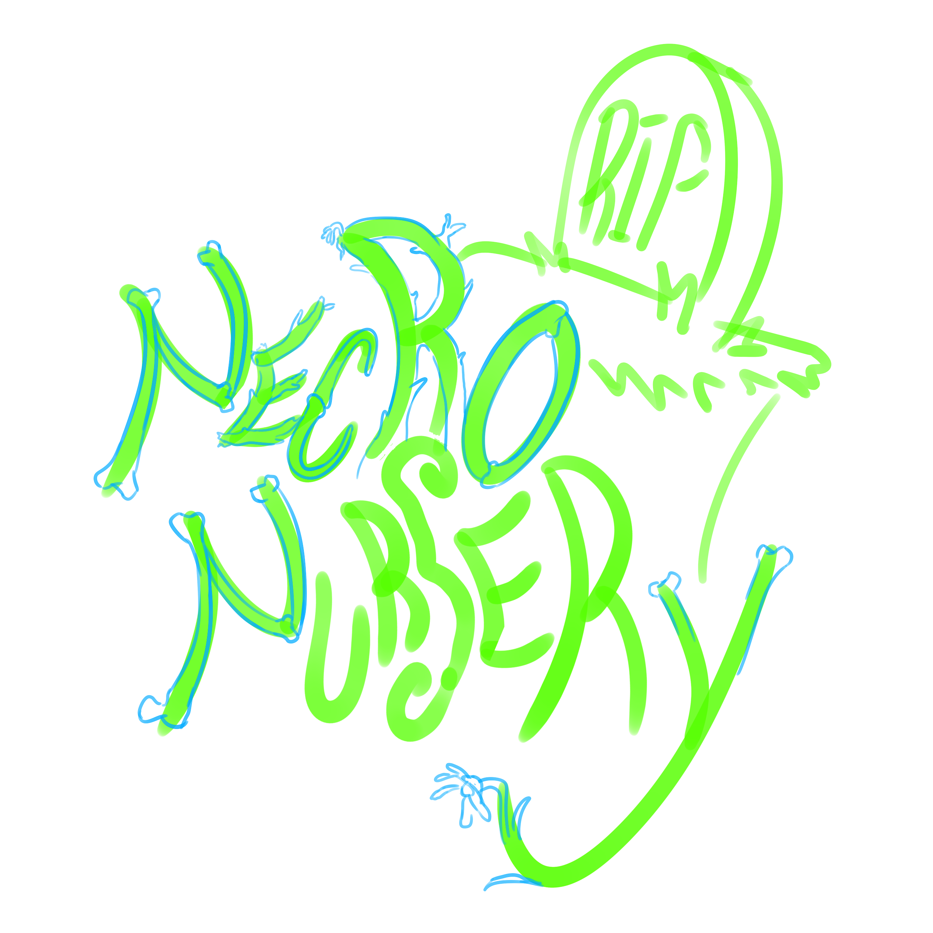
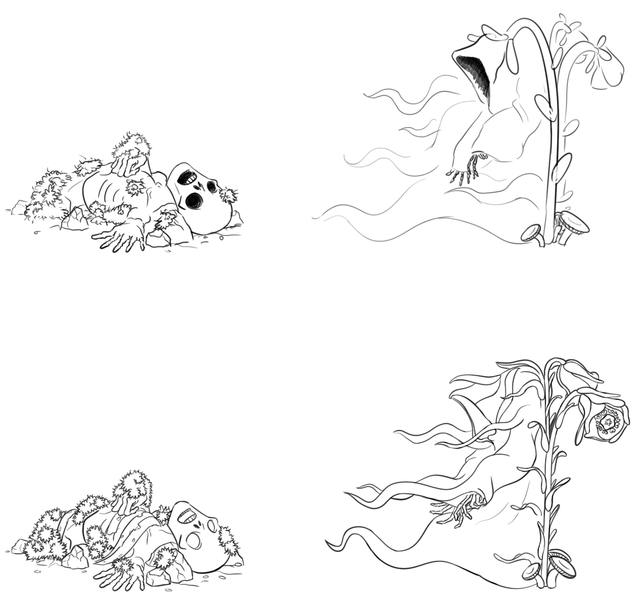
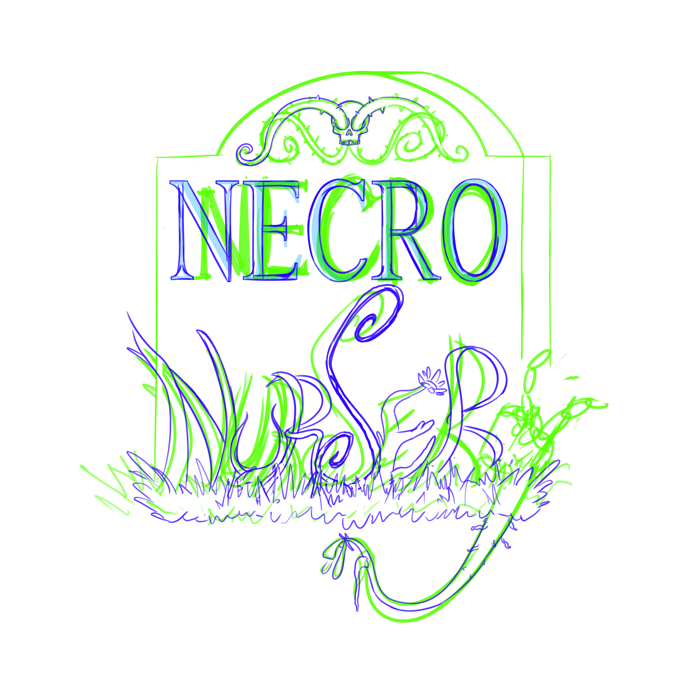
WIP

Slide 7
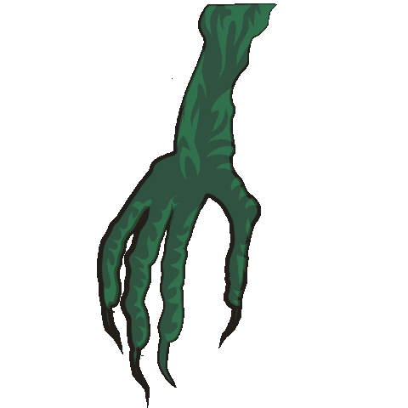
Programming
Saving and loading completed- breaking
Morgue works! Until it doesn’t
Bug fixes and minor updates
Mostly finished assets put in over placeholders

Slide 8
Troubles along the way?
Lots of bugs discovered
Merchant basically disabling the game
Morgue working only once and then softlocking
Restarting the game can let you grow your monsters without giving them resources

Slide 9
What we plan to do!
Finish poster before Nanocon
Bug fixes for Nanocon
Get all art assets in before Nanocon

Slide 10
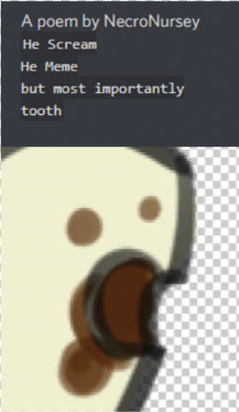
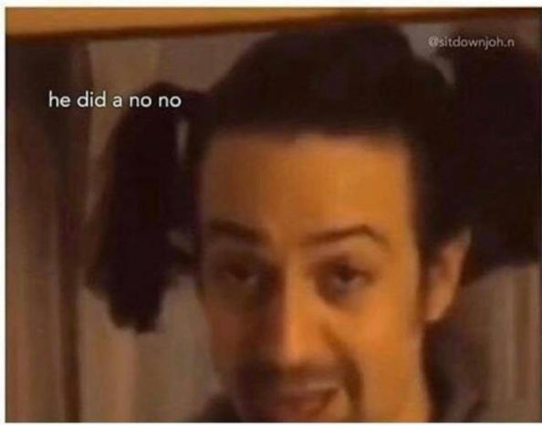
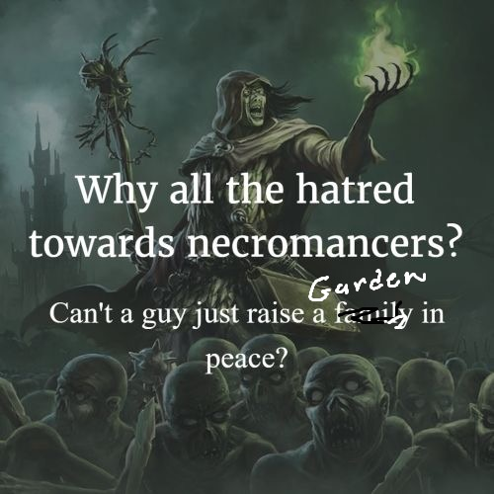
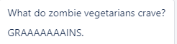
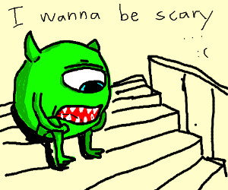
Questions?

